Slide 1

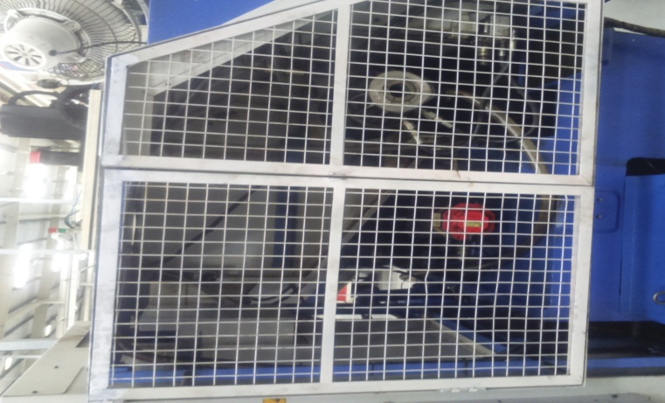
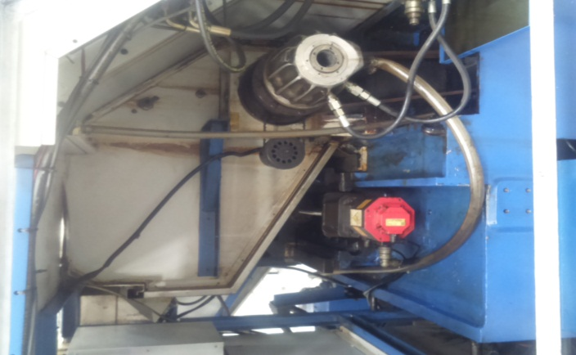
AHPL/QMS/FR/09/E
TPM CIRCLE NO :-
ACTIVITY
KK
QM
PM
JH
SHE
OT
DM
E&T
KAIZEN IDEA SHEET
TPM CIRCLE NAME:
LOSS NO. / STEP
DEPT :-
RESULT AREA
P
Q
A
C
D
S
M
CELL:- Oil Pump
CELL NAME :- A131 Body
MACHINE / STAGE :- Machining
OPERATION :- Facing
KAIZEN THEME : To Eliminate Unsafe Act.
IDEA :- Guard to be Provide
Problem present status :- A 131 Body Machine CNC Jobber XL Spindle Motor Area Not Covered. So Chance of Accident.
COUNTERMEASURE:- Localize Guard to be Provide to Avoid Accident.
BENCHMARK
Unsafe Condition
TARGET
0 Accident
KAIZEN START
10.04.2017
TDC
12.05.2017
KAIZEN FINISH
27.05.2017
TEAM MEMBERS : Nilesh Khadke,
Dilip Phapale,
Sachin Chaudhari.
BENEFITS :-
Unsafe Condition Eliminate
Before
After
KAIZEN SUSTENANCE
WHY - WHY ANALYSIS :-
Not Applicable
RESULT :-
1) Eliminate Unsafe Condition.
2) Safety Working Condition.
WHAT TO DO:- NA
HOW TO DO:- NA
FREQUENCY :- NA
ROOT CAUSE :- NA
REGISTRATION NO. & DATE : 27.05.2017
SCOPE & PLAN FOR HORIZONTAL DEPLOYMENT
REGISTERED BY :- Umesh Pimple
SR.
NO.
CELL
TARGET
RESPONSIBILITY
STATUS
MANAGER’S SIGN :- Dnyaneshwar Pawar
Tensioner
30.5.17
SC
Comp.
Rev. No.:01, Rev. Date:15.12.2016

